Slide 1

Retail Sales Data Analysis using Python
Analyzing Customer Insights and Sales Trends for Strategic Growth
By: Samruddhi Jadhav | Certified Data Analyst
Tools Used: Python, Pandas, Matplotlib, Seaborn, Jupyter Notebook

Slide 2

Project Objectives: Driving Retail Success with Data
Understand Customer Behavior
Identify Top Performers
Pinpoint the most successful product categories and geographical regions to optimize resource allocation.
Deep dive into purchasing patterns, preferences, and demographics to create targeted strategies.
Improve Business Decisions
Leverage data-driven insights to make informed choices that boost sales and profitability.

Slide 3


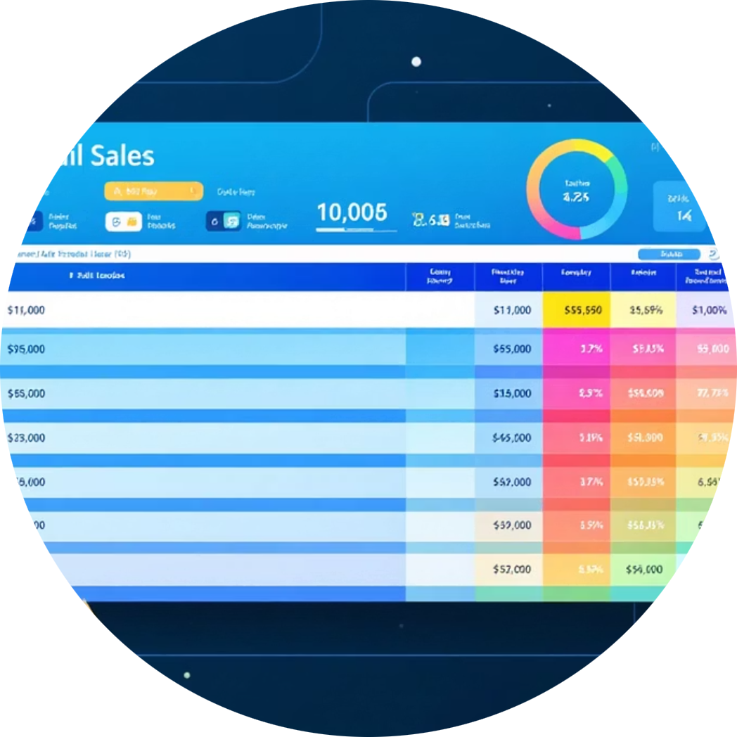
Powerful Tools & Technologies for Analysis
Python Libraries
Development Environment
Comprehensive Dataset
Leveraging Pandas for data manipulation, NumPy for numerical operations, and Matplotlib/Seaborn for advanced visualizations.
Utilizing Jupyter Notebook for an interactive and iterative analysis workflow.
Analyzing a rich dataset including sales transactions, customer demographics, product details, and regional information.

Slide 4
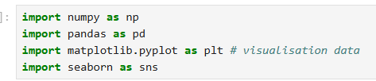
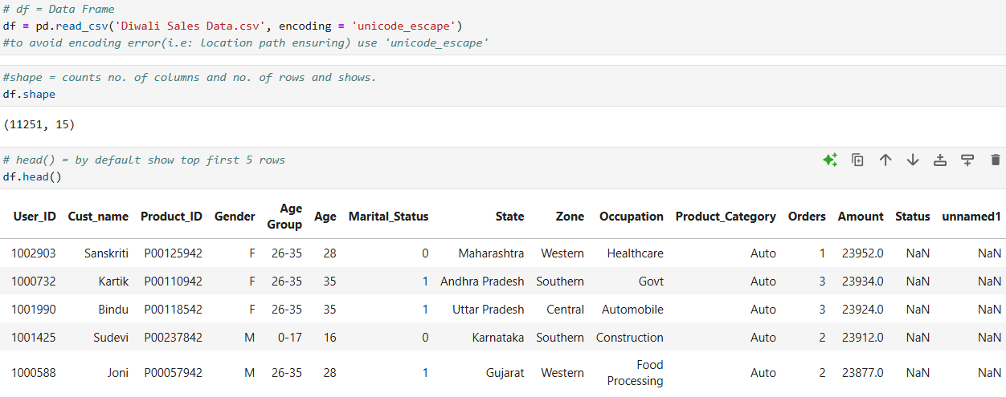
Powerful Tools & Technologies for Analysis
Python Libraries
Development Environment
Comprehensive Dataset
Leveraging Pandas for data manipulation, NumPy for numerical operations, and Matplotlib/Seaborn for advanced visualizations.
Utilizing Jupyter Notebook for an interactive and iterative analysis workflow.
Analyzing a rich dataset including sales transactions, customer demographics, product details, and regional information.

Slide 5
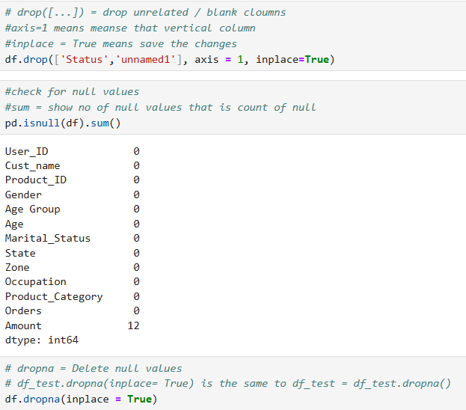


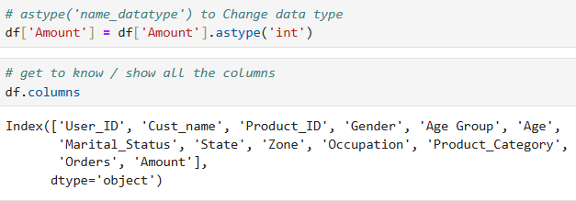


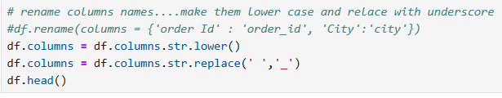
Data Cleaning & Preparation: The Foundation of Reliable Insights
Handle Missing Values
Implemented robust techniques to address and impute missing data points, ensuring data integrity.
Eliminate Duplicates
Identified and removed redundant entries to prevent skewed analysis and maintain data accuracy.
Correct Data Types
Ensured proper formatting of dates, numeric fields, and categorical variables for accurate processing.
Filter Relevant Features
Focused on key attributes essential for deeper analysis, streamlining the dataset for efficiency.

Slide 6

Exploratory Data Analysis (EDA): Uncovering Patterns
Performed Univariate Analysis to understand individual variable distributions.
Conducted Bivariate Analysis to examine relationships between pairs of variables.
Utilized Matplotlib and Seaborn to create insightful visualizations, revealing hidden trends.
Derived actionable insights into sales distribution, identifying top customers and high-performing regions.

Slide 7
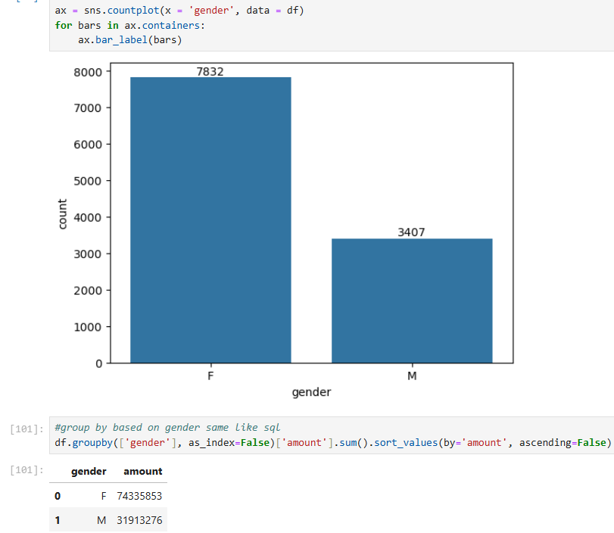
Exploratory Data Analysis (EDA): Uncovering Patterns
From the graph we can see that most of the buyers are females.
Even the purchasing power of females are greater than men.

Slide 8
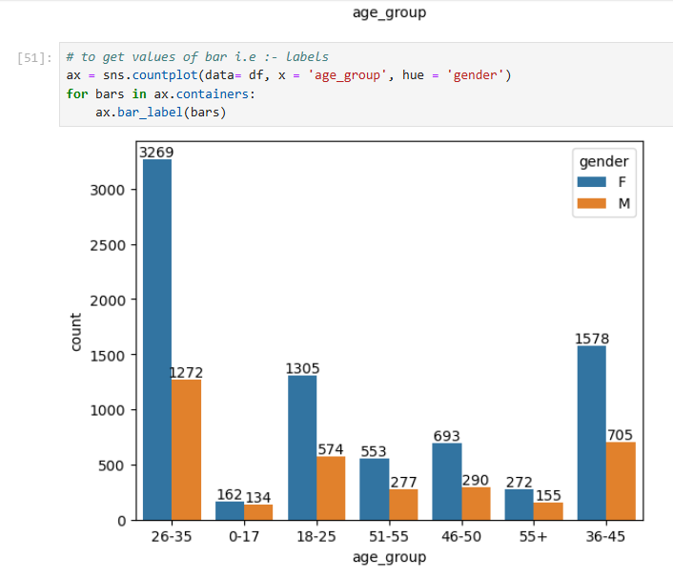
Exploratory Data Analysis (EDA): Uncovering Patterns
From above graphs we can see that most of the buyers are age group between 26-34 yrs female

Slide 9
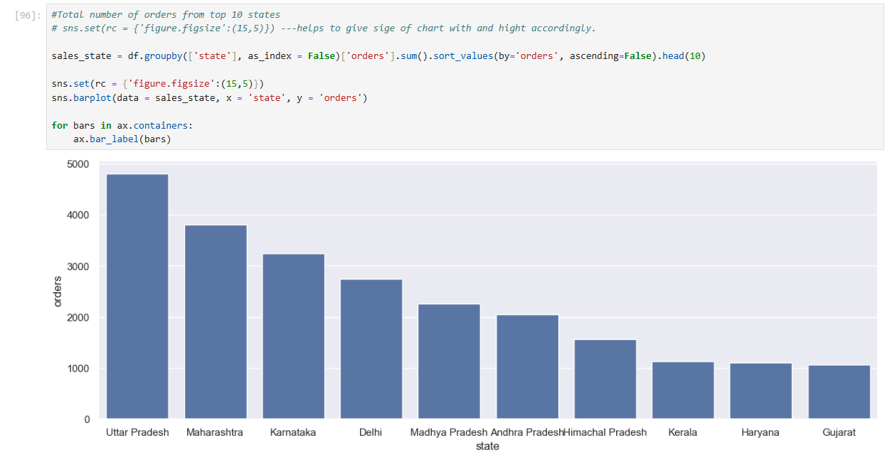
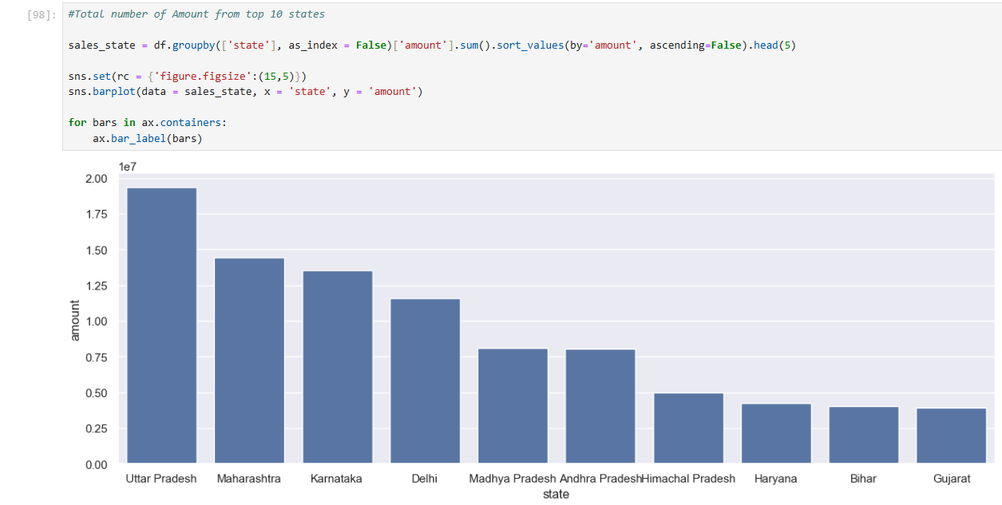
Exploratory Data Analysis (EDA): Uncovering Patterns
so, we get to know that the most of the people who done orders from Uttar Pradesh, Then Maharashtra, then follow by Karnataka state and then Delhi and 5th most is Madhya Pradesh, so and so forth we have taken top 5 state you can change it accordingly.
From above graphs we can see that most of the orders are from Uttar Pradesh, Maharashtra and Karnataka respectively.

Slide 10
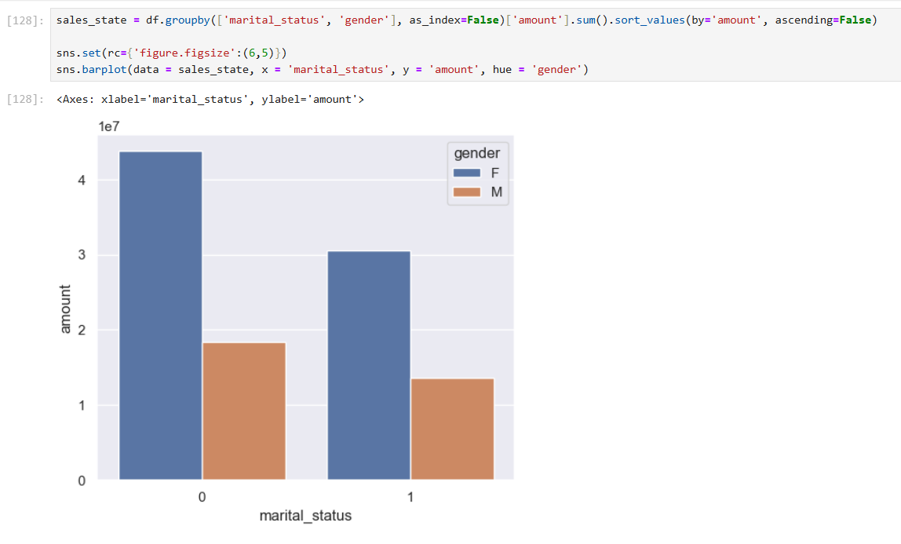
Exploratory Data Analysis (EDA): Uncovering Patterns
From the graphs we can see that most of the buyers are married(women) and they have high purchasing power.

Slide 11
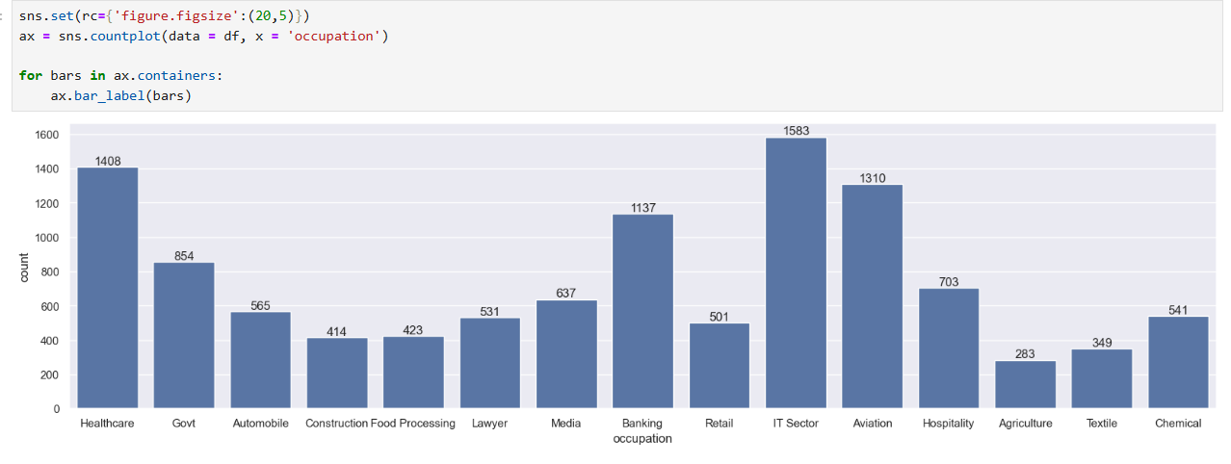
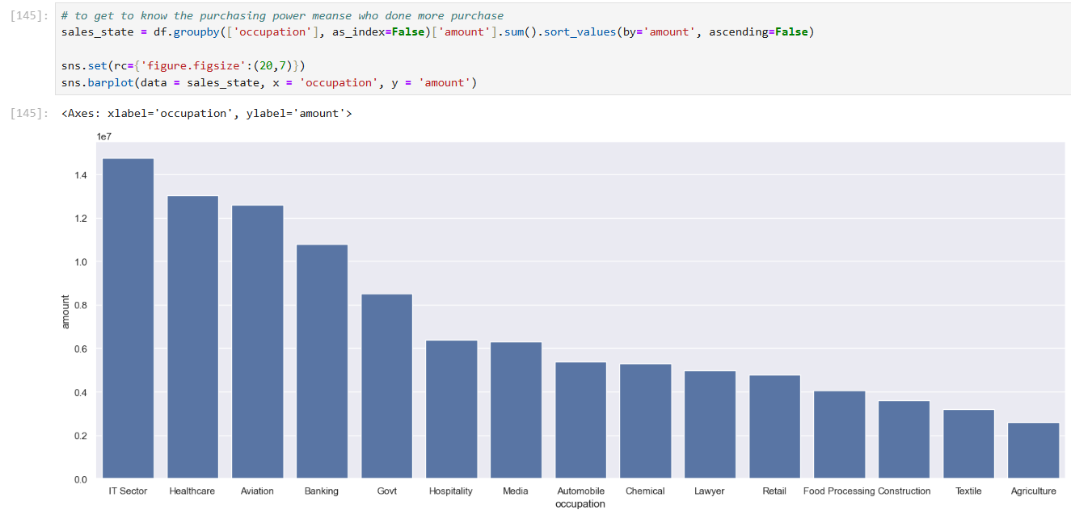
Exploratory Data Analysis (EDA): Uncovering Patterns
From the graph we can see that most of the buyers are working in IT, Healthcare and Aviation sector

Slide 12
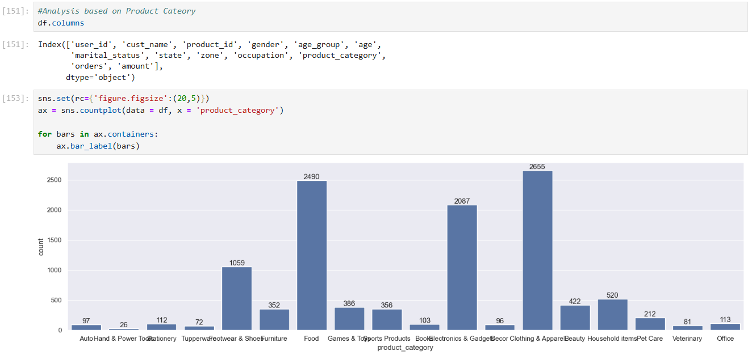
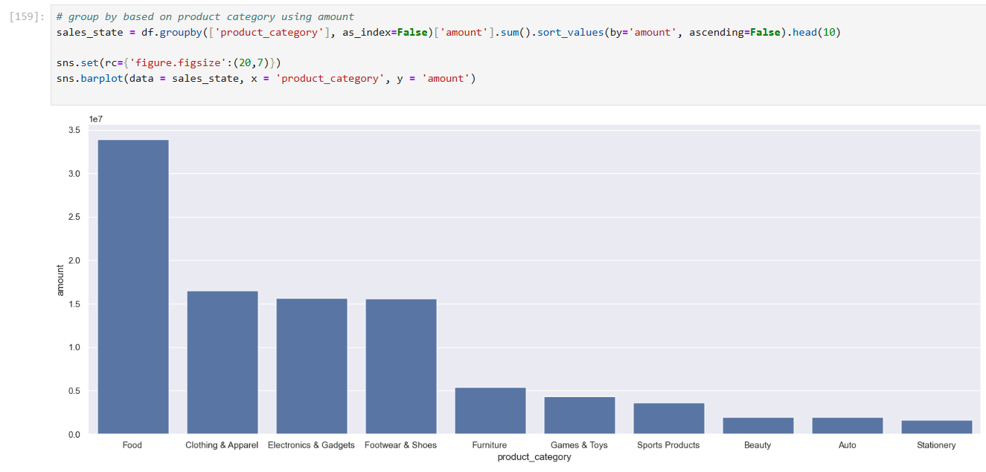
Exploratory Data Analysis (EDA): Uncovering Patterns
From the graphs we can see that most of the sold products are from food, clothing and Electronics category

Slide 13
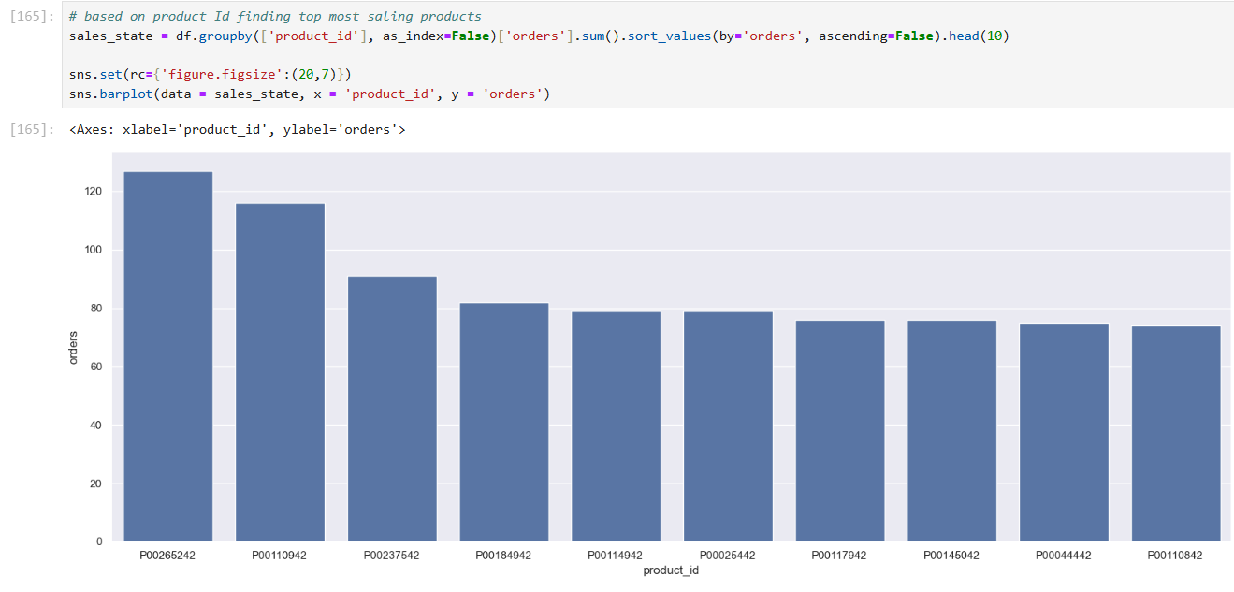
Exploratory Data Analysis (EDA): Uncovering Patterns
Married women age group 26-35 yrs from UP, Maharashtra and Karnataka working in IT, Healthcare and Aviation#are more like buy products from Food, Clothing and Electronic category.

Slide 14
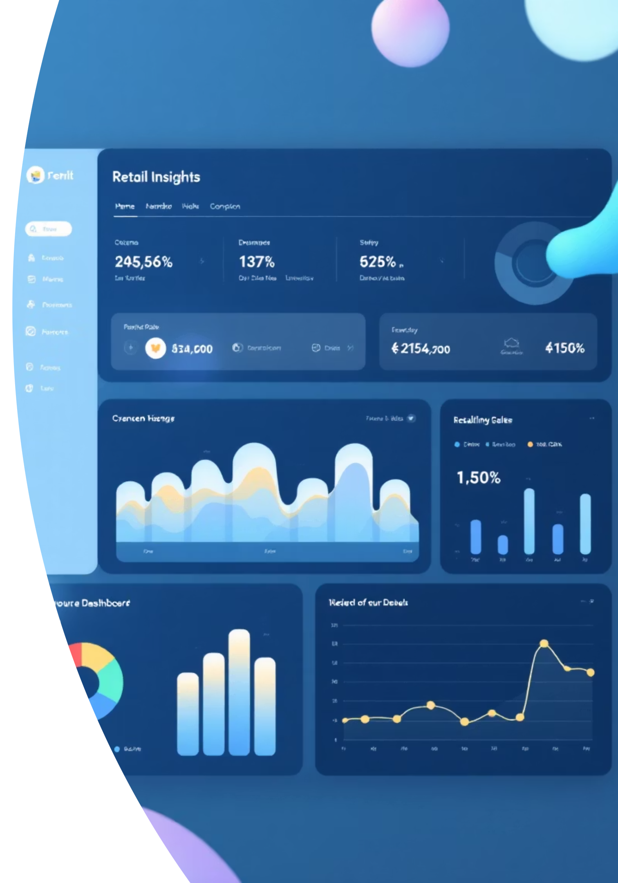








Key Insights: Understanding Our Retail Landscape
Geographical Sales Dominance
Certain states consistently registered the highest sales figures, indicating strong regional markets.
Top-Selling Categories
Electronics and Furniture emerged as the leading product categories, driving significant revenue.
Customer Age Profile
The most active customer segment falls within the 25-40 years age bracket, a key demographic for targeting.
Gender-Based Purchase Frequency
Male customers exhibited a slightly higher purchase frequency compared to other demographics.

Slide 15



Translating Data into Business Impact
Optimized Customer Targeting
Identified potential customers based on location, occupation, and gender, enabling more effective marketing campaigns.
Enhanced Inventory Planning
Informed inventory decisions by highlighting high-demand products and categories, reducing stockouts and excess.
Improved Sales Forecasting
Leveraged historical data and trends to produce more accurate sales forecasts, supporting strategic financial planning.

Slide 16

Project Learnings: Key Takeaways from the Journey
Data Cleaning Mastery
Gained proficiency in cleaning and manipulating messy datasets for reliable analysis.
EDA Expertise
Honed skills in exploratory data analysis using Pandas, Matplotlib, and Seaborn.
Actionable Insights
Developed the ability to translate complex data into clear, actionable business recommendations.
Visual Storytelling
Enhanced capabilities in presenting data through compelling and easy-to-understand visualizations.

Slide 17





Challenges & Solutions: Navigating the Data Landscape
Missing & Inconsistent Data
Complex Visualizations
Addressed data quality issues by leveraging powerful Pandas functions for imputation and standardization.
Simplified intricate data relationships using Seaborn's advanced plotting capabilities for enhanced clarity.
Large Dataset Management
Optimized processing efficiency through strategic use of groupby operations and targeted data filtering.

Slide 18
Conclusion: Empowering Data-Driven Retail
This project successfully leveraged Python for a comprehensive retail sales data analysis, yielding significant outcomes:
Identified Key Customer Segments: Unveiling critical demographics and behaviors to refine marketing efforts.
Pinpointed Top-Selling Products: Providing insights for inventory optimization and product development.
Enabled Data-Driven Decision Making: Equipping stakeholders with insights to make informed strategic choices.
Strengthened Python Data Analysis Skills: Solidifying expertise in a crucial tool for modern business analytics.
This analysis paves the way for a more efficient, profitable, and customer-centric retail strategy.

Slide 19
Thank
You….!!!

